Slide 1



Beyond a Centralized Verifier: Scaling Data Plane Checking via Distributed, On-Device Verification
Qiao Xiang¹, Chenyang Huang¹, Ridi Wen¹, Yuxin Wang¹, Xiwen Fan¹,
Alan Liu², Linghe Kong³, Dennis Duan⁴, Franck Le⁵, Wei Sun⁶
¹Xiamen University, ²University of Maryland, ³Shanghai Jiao Tong University,
⁴Yale University, ⁵IBM Watson, ⁶University of Texas at Austin
September 2023, NYC, United States,
ACM SIGCOMM'23
Notes:
Hello, everyone, I am Qiao Xiang from Xiamen University, China. It's my pleasure to present our paper, Beyond a Centralized Verifier: Scaling Data Plane Checking via Distributed, On-Device Verification.

Slide 2



Network Verification: Powerful Tools to Check Network Forwarding Behaviors
High coverage on actual forwarding behaviors, and the focus of this talk
Configuration verification
Batfish [NSDI'15, SIGCOMM'23],
Minesweeper [SIGCOMM'17], …
Match | Action
10.0.0.1/24 | fwd(1)
… | …
Data plane verification (DPV)
Anteater [SIGCOMM'11], HSA [NSDI'12],
Veriflow [NSDI'13], AP [ICNP'13], …
Match | Action
10.0.0.1/24 | fwd(1)
… | …
Match | Action
10.0.0.1/24 | fwd(1)
… | …
Runtime verification
Hydra [SIGCOMM'23], …
Notes:
Network Verification is a Powerful Tool to Check Network Forwarding Behaviors. It examines the configurations, the forwarding tables or ACLs, or the runtime of routers and switches, to determine whether a network would forward or are actually forwarding packets along pre-determined sets of paths.
This talk focuses on data plane verification, or DPV for short, because they provide a high coverage of the actual forwarding behaviors of the network.

Slide 3
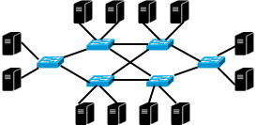
How Does DPV Usually Work?
A (cluster of) server(s) as a centralized verifier
Collect the data plane (e.g., FIB/ACL) from routers/switches through a management network
Run computation-intensive, memory-intensive algorithms to verify the network data plane
Verifier
Management
Network
FIB/ACL
FIB/ACL
FIB/ACL
FIB/ACL
Notes:
DPV tools usually adopt an SDN-like architecture. A cluster of servers play the role of a centralized verifier. It collects the data plane from routers and switches through a management network, and then run computation-intensive, memory-intensive algorithms to verify the network

Slide 4
Centralized DPVs Do Not Scale
Need a highly-available management network
Incomplete DP, inconclusive result
Verifier becomes performance bottleneck
Larger network, more computation power
Verifier becomes single PoF
Verifier fails, no result
Out-of-band verification
Slow reaction to errors
Verifier
Management
Network
FIB/ACL
FIB/ACL
FIB/ACL
FIB/ACL
Notes:
Although people have designed very powerful data structures and algorithms such as atomic predicates to improve the efficiency of the verifier, centralized DPVs do not scale to large networks due to its architectural limitations. Specifically, it requires a highly-available management network, which is hard to build. The verifier itself also becomes a performance bottleneck and single PoF. More importantly, because the verification happens outside the network, reacting to the found errors is slow as the decisions need to go through the management network again.

Slide 5
Our Proposal: Distributed, On-Device Verification
Basic idea: offload verification to distributed computations on network devices
Benefits:
Minimize the involvement of management network
Once configured, run automatically
No performance bottleneck
More network devices, more verifiers
No single PoF
Device malfunction equals a network error
Verification-as-a-service for vendors
Support flexible in-situ fast reroute
Fundamental challenge:
How to achieve flexible, correct distributed DPV on commodity switches?
Verifier
On-device tasks
On-device tasks
On-device tasks
On-device tasks
Management
Network
FIB/ACL
FIB/ACL
FIB/ACL
FIB/ACL
Notes:
To tackle these scaling limitations of DPV, we propose distributed, on-device verification. Our basic idea is to offload verification to distributed computations on network devices. By removing the centralized verifier, this distributed architecture minimizes the involvement on management network, avoids the verifier becoming a bottleneck or single PoF. It also could support flexible in-situ fast reroute such as convergence free routing by allowing vendors to provide verification-as-a-service
With all these potential benefits from the architecture point of view, a fundamental challenge remains: that is, how to achieve flexible, correct distributed DPV on commodity switches?

Slide 6

An Illustrating Example
Invariant: all packets entering the network from S with a destination IP in 10.0.0.0/23 must be delivered to D in a simple path waypointing W.
Topology:
B
S
A
D
W
10.0.0.0/23
Notes:
We illustrate how we tackle this fundament challenge with an example. Suppose the operator wants to verify in this topology, whether all packets entering the network from S with a destination IP in 10.0.0.0/23 will be delivered to D in a simple path waypointing W.

Slide 7
Invariant Specification
Invariant: all packets entering the network from S with a destination IP in 10.0.0.0/23 must be delivered to D in a simple path waypointing W.
Declarative program in 4-tuple:
(dstIP = 10.0.0.0/23, [S], S .* W .* D and loop_free, "exist >=1")
packet space
set of
valid paths
number of
allowed valid paths
ingress
Notes:
We first design a declarative language for operator to specify this invariant in a 4-tuple of the packet space, ingress, set of valid paths expressed in regular expression, and number of valid paths allowed in the network.

Slide 8
Key Insight: Transform DPV into Counting on DAG
DPV: count how many valid paths exist in the data plane
DPV on DPVNet: count valid paths via reverse topological traversal
B
DPVNet: a DAG representing all valid paths in the topology
S
A
D
B1
W1
W
10.0.0.0/23
S1
A1
Topology:
X (DFA multiplication)
W2
B2
Invariant:
(dstIP = 10.0.0.0/23, [S],
S .* W .* D and loop_free, "exist >=1")
D1
Notes:
Given the topology and the specified invariant, the problem of DPV can be defined as to count how many valid paths exist in the data plane. To decompose this computation-intensive problem, our key insight is that by treating the topology as a deterministic finite automata and multiply it with the regular expression in the invariant, we can compute a DAG called the DPVNet, which compactly represents all valid paths in the topology. Afterwards, the problem of DPV can be solved by a reverse topological traversal along the DPVNet.

Slide 9
Decomposing Reverse Counting to Per-Node On-Device Tasks
Per-node on-device task: count # of downstream paths provided by data plane in reverse topological order
[(P₁, 0)]
Match | Action
P₂ | fwd(ALL, {B, W})
P₃ | fwd(ANY, {B, W})
P₄ | fwd(ALL, {W})
Match | Action
P₂ | drop
P₃ U P₄ | fwd(ALL, {D})
[(P₂ U P₄, 1),
(P₃, [0, 1])]
B1
W1
[(P₁, 1)]
S1
A1
[(P₂, 0),
(P₃ U P₄, 1)]
P₁= P₂ U P₃ U P₄
B
[(P₂ U P₄, 1),
(P₃, [0, 1])]
S
A
D
W2
B2
Error found!
W
10.0.0.0/23 (P₁)
[(P₁, 1)]
Match | Action
P₁ | fwd(ALL, {A})
Match | Action
P₁ | fwd(ALL, {D})
D1
[(P₁, 1)]
Notes:
This reverse counting can be naturally decomposed into on-device tasks corresponding to nodes on the DPVNet, where each node counts the number of downstream paths provided by the data plane, and sends the result to all its upstream neighbors.
To illustrate the process, assume device D's action is to forward all packets in 10.0.0.0/23, denoted as P1, to the corresponding egress.
Therefore, D1's counting is (P1, 1). D sends D1's results to the devices of D1's upstream neighbors, W1, W2, B2.
When W receives the result, because W forward P1 to D, W1 and W2 each updates its counting to (P1, 1).
However, because B only forwards packets in P3 and P4 to D, but drops packets in P2, B2's counting is updated as (P2, 0) and (P3 and P4, 1).
W and B then each sends the results of W1, W2 and B2 to these nodes' upstream neighbors. The process continues as B1 updates its result to (P1, 0) because B1's downstream neighbor is W1, but B does not forward any packet to W.
When A receives the results of both B1 and W2, A1 will update its results for P2 and P4 as 1. This is because although A forwards P2 to both B and W, because B1's results is 0 and W2 is 1, the counting results of A1 for P2 is calculated as 1+0 equals to 1. For packets in P3, A forwards them either to B or W, but not both, depending on the blackbox hashing algorithm of device A. Therefore, the counting of P3 at A1 has 2 possibilities: 0 or 1.
After A sends the results to S, the ingress of the invariant, and S computes its own result, S will determine that the invariant is violated because not all packets in P1 can always be delivered to D along a simple path passing W.

Slide 10
Incremental Verification via Event-Driven, Incremental Counting
Per-node on-device task: count # of downstream paths provided by data plane in reverse topological order incrementally and consistently
[(P₁, 0)]
[(P₂, 0),
(P₃ U P₄, 1)]
Match | Action
P₂ | fwd(ALL, {B, W})
P₃ | fwd(ANY, {B, W})
P₄ | fwd(ALL, {W})
Match | Action
P₂ | drop
P₃ U P₄ | fwd(ALL, {D})
[(P₂ U P₄, 1),
(P₃, [0, 1])]
B1
W1
fwd(ALL, {W})
[(P₁, 1)]
S1
A1
[(P₁, 1)]
[(P₂, 0),
(P₃ U P₄, 1)]
P₁= P₂ U P₃ U P₄
B
[(P₂ U P₄, 1),
(P₃, [0, 1]),]
S
A
D
W2
B2
[(P₁, 1)]
[(P₁, 0)]
W
10.0.0.0/23 (P₁)
[(P₁, 1)]
Correct!
Match | Action
P₁ | fwd(ALL, {A})
Match | Action
P₁ | fwd(ALL, {D})
D1
[(P₁, 1)]
Notes:
This distributed counting is event-driven and incremental. Suppose B updates its action to forward P3 and P4 to W. nodes B1 and B2 will update their counting accordingly, and then send to their upstream neighbors in the DPVNet for further updates. Eventually, S will update its result to (P1, 1), indicating that the network data plane is correct. Our design guarantees the eventual consistency: assuming the network becomes stable at some point, the ingress devices will eventually update its count result to be consistent with the network data plane.

Slide 11
Tulkun: A Generic, Distributed, On-Device DPV Framework
Declarative Invariant Specification Language
Verification
Invariant
Network
Topology
+
DPVNet
Verification Planner
On-Device Tasks
On-Device Verifiers
/ DVM Protocol
Verification Messages
The basic architecture and workflow of the Tulkun framework
Notes:
Putting things together, we develop a generic, distributed, on-device DPV framework called Tulkun, consisting of an invariant specification language for operators, a verification planner to compute the DPVNet and decompose it into on-device tasks, and a messaging protocol specifying how neighboring devices communicate counting results in an efficient, correct way.

Slide 12
Tulkun: Extensions
Data plane with packet transformation
Sub-pub mechanism added to on-device tasks
Message-free local verification
All-path-availability: any task finding error equals network error (Microsoft RCDC [SIGCOMM'19] becomes a special case)
Fault-tolerant invariant (e.g., shortest path under k-link-failure)
Precomputing fault-tolerant DPVNet and online adjustment
Incremental deployment
device/vm interconnect + partition
Notes:
Tulkun has a series of extensions, including a sub-pub mechanism to verify packet transformations, a message-free local verification optimization, making Azure RCDC a special case, a precomputing mechanism to verify invariants such as shortest path under k-link-failure, and an incremental deployment design.

Slide 13
Implementation
A total ~8K lines of Java code
On-device verifier runs on SONiC/ONL
Requirement: JRE
SONiC HLD proposal
github.com/sonic-net/SONiC/pull/948
Open-sourced at
github.com/sngroup-xmu/ddpv-public
Notes:
We implement an open-source prototype of Tulkun and propose its design to the SONiC community

Slide 14
Experiment 1: Functionality Demonstration
6-switch testbed: 4 Mellanox, 1 UfiSpace, 1 Edgecore
Demo scenarios:
Waypoint reachability
Multicast
Anycast
Different-ingress consistent reachability
All-shortest-path availability
Video/interactive demos: distributeddpvdemo.tech
B
C
S
A
D
W
Notes:
To evaluate Tulkun's capability and performance, we first build a 6-commodity-switch testbed to demonstrate how to verify flexible invariants, such as waypoint reachability, multicast, anycast, different-ingress consistent reachability and all-shortest-path availability. We also design an interactive frontend backed with a simulator for visitors to try out Tulkun with different topologies and invariants.

Slide 15
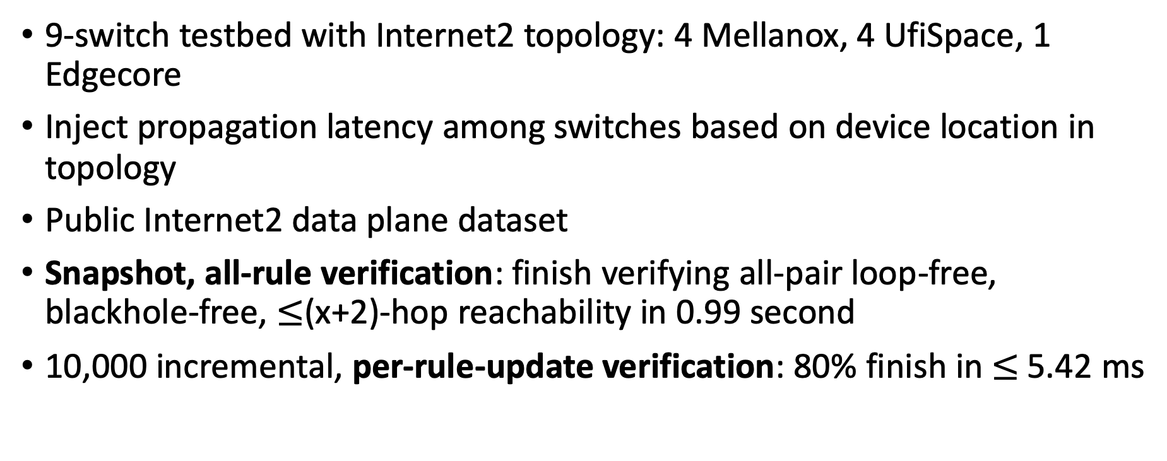
Experiment 2: Verifying Internet2
9-switch testbed with Internet2 topology: 4 Mellanox, 4 UfiSpace, 1 Edgecore
Inject propagation latency among switches based on device location in topology
Public Internet2 data plane dataset
Snapshot, all-rule verification: finish verifying all-pair loop-free, blackhole-free, $≤$(x+2)-hop reachability in 0.99 second
10,000 incremental, per-rule-update verification: 80% finish in $≤$5.42 ms
Notes:
We then build a 9-switch testbed mimicking the early Internet2 by using its public dataset and injecting propagation latency based on the geo information of the topology. Tulkun verifies the all-pair loop-free, blackhole-free, limited-path reachability of the snapshot in less than 1 second, and 80% of incremental verification in 5.42 ms.

Slide 16
Experiment 3: Large-Scale Simulations
13 datasets spanning campus networks, WAN and DCN
Compare with 5 centralized DPV tools:
Veriflow [NSDI'13]
Delta-net [NSDI'17]
AP [ICNP'13]
APKeep [NSDI'20]
Flash [SIGCOMM'22]
Notes:
We also compare Tulkun with 5 centralized DPV tools over 13 datasets using simulation, spanning campus network, WAN and DCN.

Slide 17
Simulation: Snapshot Verification
Tulkun is substantially faster than all tools in comparison, and can verify a 6000-device DCN in 40.45 seconds
Notes:
In snapshot verification, Tulkun is substantially faster than all tools in comparison, and can verify a 6000-device DCN in less than 41 seconds.

Slide 18
Simulation: 10,000 Incremental Per-Rule-Update Verification
Tulkun verifies at least 73% of rule updates in less than 10 ms and up to 2355x faster than SOTA in 80% quantile
Notes:
For incremental verification, Tulkun verifies at least 73% of rule updates in less than 10 ms in all datasets and up to 2355x faster than SOTA in 80% quantile.

Slide 19
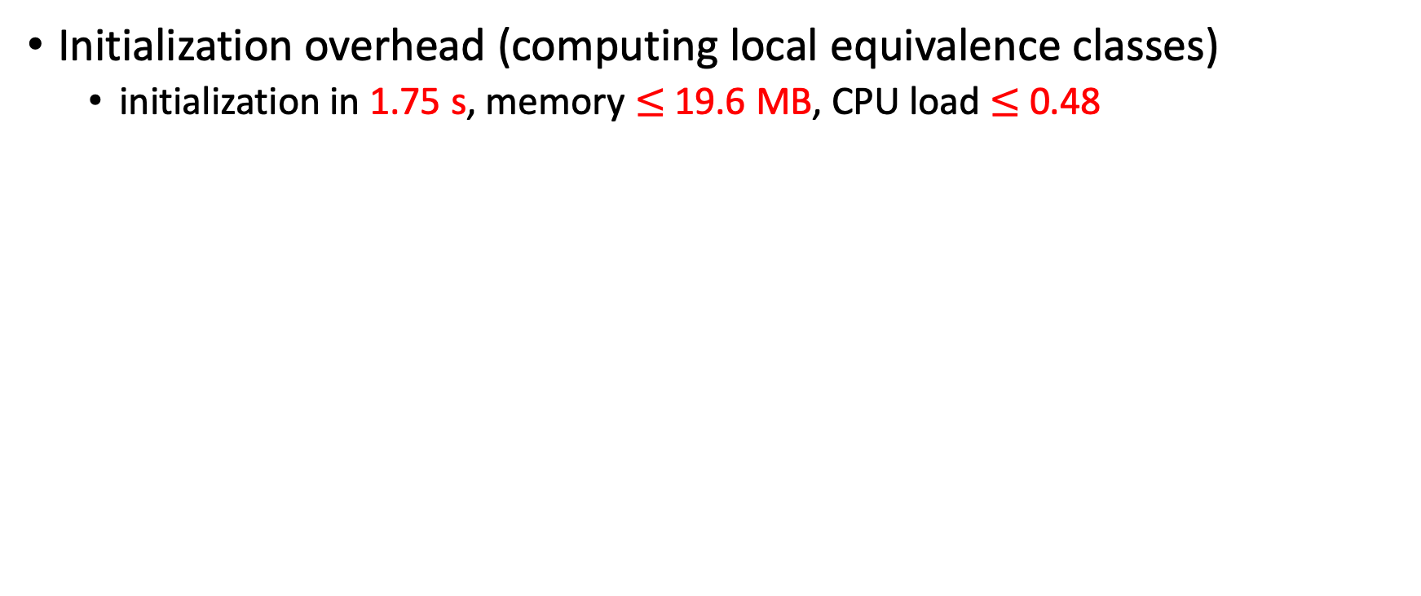
Experiment 4: Microbenchmark on Commodity Switches
Initialization overhead (computing local equivalence classes)
initialization in 1.75 s, memory $≤$ 19.6 MB, CPU load $≤$ 0.48
Notes:
For all our devices in simulation, we run trace-based microbenchmark on 4 models of commodity switches, including one using ARM-based CPU. On all four switches, all devices in the datasets complete initialization in ≤ 1.75𝑠, a maximal memory of 20𝑀𝐵 and a small CPU load.

Slide 20
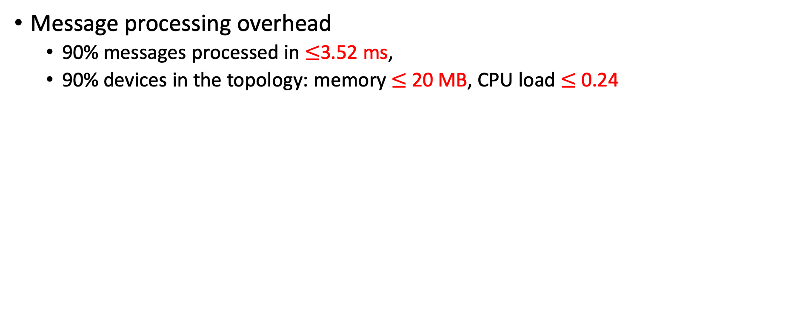
Experiment 4: Microbenchmark on Commodity Switches
Message processing overhead
90% messages processed in $≤$3.52 ms,
90% devices in the topology: memory $≤$20 MB, CPU load $≤$ 0.24
20
0.24
3.52
Notes:
For 90% messages, all switches process it in <= 3.52ms, with low CPU and memory overhead

Slide 21
What Is Next for Distributed Verification?
For more information about us, email qiaoxiang@xmu.edu.cn, or visit sngroup.org.cn
Our vision:
Scalable, reliable,
full-stack
network verification
Distributed / Interdomain configuration verification and diagnosis
InCV [APNet'23], Scalpel [APNet'23], DistDNS [WIP]
Match | Action
10.0.0.1/24 | fwd(1)
… | …
Distributed DPV
Tulkun [HotNets'22, SIGCOMM'23]
Match | Action
10.0.0.1/24 | fwd(1)
… | …
Match | Action
10.0.0.1/24 | fwd(1)
… | …
better scalability, no single PoF, VaaS for vendors
code/demo:
github.com/sonic-net/SONiC/pull/948
github.com/sngroup-xmu/ddpv-public
distributeddpvdemo.tech
Distributed runtime verification
DistDevCheck [WIP]
Notes:
To summarize, in this talk, we propose to scale DPV by offloading verification computation to lightweight, distributed computing on commodity network devices, and demonstrate its feasibility and benefits. In the future, we are expanding its scope to distributed and interdomain configuration verification and diagnosis, with preliminary results appear at APNet23 and an ongoing work on DNS verification. We also find synergies between our work and Hydra, and are investigating to extend Tulkun to support distributed runtime verification. Thank you for listening. I'm happy to take any questions.

Slide 22
Backup Slides

Slide 23
Per-device Total Message Processing Time

